Slide 1
Docker 101
Michael Simons (msimons)
Notes:
BIO
Working with Docker for almost 1 ½ years
Driving Docker story for the .NET Core product
.NET Core team relies on Docker heavily within engineering infrastructure
How many people have heard of Docker?
How many people have used Docker?

Slide 2
Agenda
What Problem is Docker Solving
What is Docker
Demo
Q & A

Slide 3
Market View: Evolution of IT
1995
2015
Thin app on mobile, tablet
Thick, client-server app on thick client
Well-defined stack:
- O/S
- Runtime
- Middleware
Assembled by developers using best available services
Running on any available set of physical resources
(public/private/
virtualized)
Monolithic
Physical
Infrastructure

Slide 4
Challenges
2015
Thin app on mobile, tablet
Assembled by developers using best available services
How to ensure services interact consistently, avoid dependency hell
How to avoid n X n different configs
Running on any available set of physical resources
(public/private/
virtualized)
How to migrate & scale quickly, ensure compatibility

Slide 5

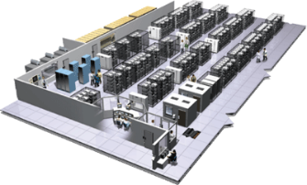
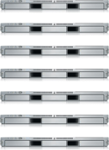
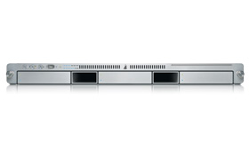
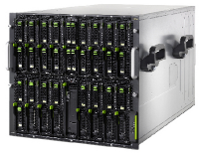

The Challenge
User DB
Static website
Queue
Analytics DB
Do services and apps interact appropriately?
Multiplicity of Stacks
Background workers
Web frontend
API endpoint
Production Cluster
Development VM
Public Cloud
Multiplicity of hardware environments
Can I migrate smoothly and quickly?
QA server
Disaster recovery
Customer Data Center
Contributor’s laptop
Production Servers

Slide 6
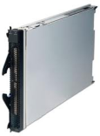
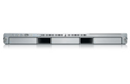
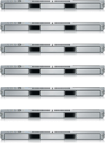


Results in N X N compatibility nightmare
? | ? | ? | ? | ? | ? | ?
? | ? | ? | ? | ? | ? | ?
? | ? | ? | ? | ? | ? | ?
? | ? | ? | ? | ? | ? | ?
? | ? | ? | ? | ? | ? | ?
? | ? | ? | ? | ? | ? | ?
Static website
Web frontend
Background workers
User DB
Analytics DB
Queue
 | Development VM | QA Server | Single Prod Server | Onsite Cluster | Public Cloud | Contributor’s laptop | Customer Servers

Slide 7
A useful analogy…

Slide 8
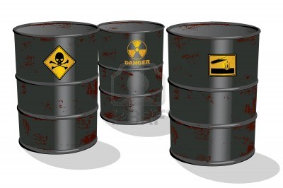
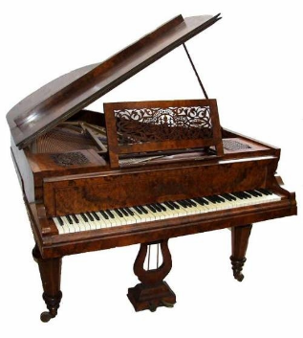

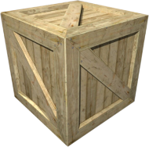
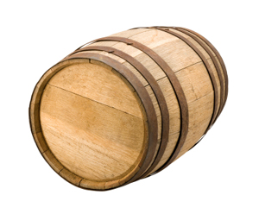
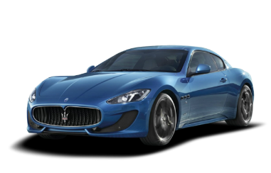
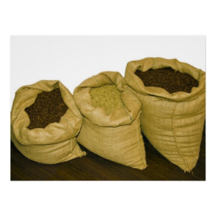



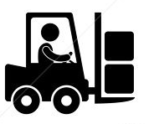
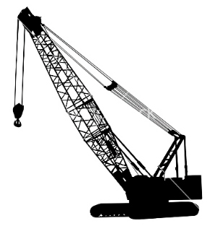
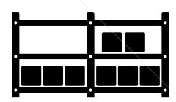

Cargo Transportation Pre-1960
Do I worry about how goods interact (e.g. coffee beans next to spices)
Multiplicity of Goods
Can I transport quickly and smoothly
(e.g. from boat to train to truck)
Multiplicity of methods for transporting/storing

Slide 9
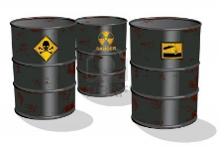

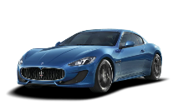


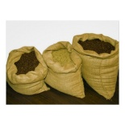


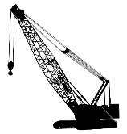



NxN Matrix
 | ? | ? | ? | ? | ? | ? | ?
 | ? | ? | ? | ? | ? | ? | ?
 | ? | ? | ? | ? | ? | ? | ?
 | ? | ? | ? | ? | ? | ? | ?
 | ? | ? | ? | ? | ? | ? | ?
 | ? | ? | ? | ? | ? | ? | ?

Slide 10

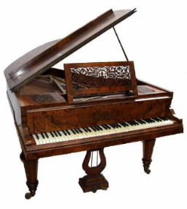

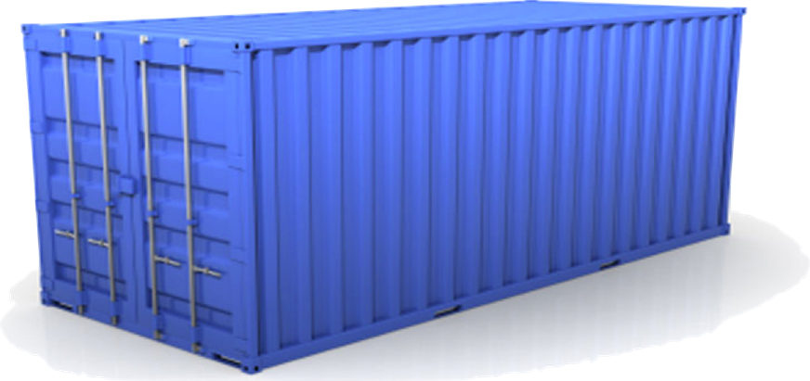
Solution: Intermodal Shipping Container
Do I worry about how goods interact (e.g. coffee beans next to spices)
Multiplicity of Goods
A standard container that is loaded with virtually any goods, and stays sealed until it reaches final delivery.
…in between, can be loaded and unloaded, stacked, transported efficiently over long distances, and transferred from one mode of transport to another
Can I transport quickly and smoothly
(e.g. from boat to train to truck)
Multiplicity of methods for transporting/storing

Slide 11


This eliminated the NXN problem…

Slide 12
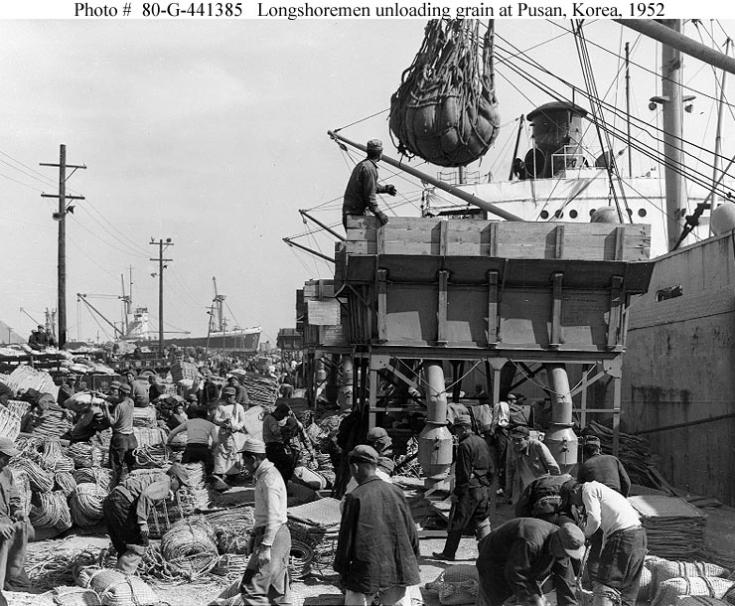
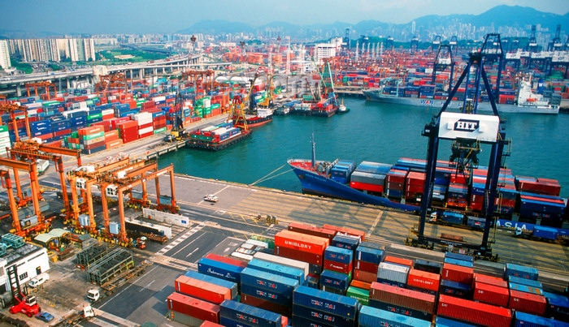
and spawned an Intermodal Shipping Container Ecosystem
90% of all cargo now shipped in a standard container
Order of magnitude reduction in cost and time to load and unload ships
Massive reduction in losses due to theft or damage
Huge reduction in freight cost as percent of final goods (from >25% to <3%)
massive globalizations
5000 ships deliver 200M containers per year

Slide 13
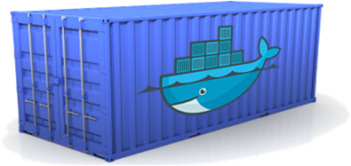
Docker is a shipping container system for code
Static website
User DB
Web frontend
Queue
Analytics DB
Do services and apps interact appropriately?
Multiplicity of Stacks
An engine that enables any payload to be encapsulated as a lightweight, portable, self-sufficient container…
…that can be manipulated using standard operations and run consistently on virtually any hardware platform
Multiplicity of hardware environments
Can I migrate smoothly and quickly
Development VM
QA server
Customer Data Center
Public Cloud
Production Cluster
Contributor’s laptop

Slide 14
Or…put more simply
Static website
User DB
Web frontend
Queue
Analytics DB
Do services and apps interact appropriately?
Multiplicity of Stacks
Developer: Build Once, Run Anywhere (Finally)
Operator: Configure Once, Run Anything
Multiplicity of hardware environments
Can I migrate smoothly and quickly
Development VM
QA server
Customer Data Center
Public Cloud
Production Cluster
Contributor’s laptop

Slide 15
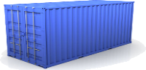
Docker solves the NXN problem
Static website
Web frontend
Background workers
User DB
Analytics DB
Queue
 | Development VM | QA Server | Single Prod Server | Onsite Cluster | Public Cloud | Contributor’s laptop | Customer Servers

Slide 16
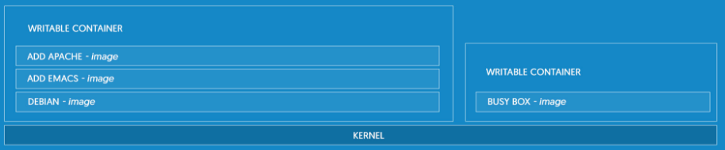
What is docker
Docker is the world's leading software containerization platform
Lightweight
Open
Secure By Default
Notes:
Docker is the world's leading software containerization platform
Docker containers wrap a piece of software in a complete filesystem that contains everything needed to run: code, runtime, system tools, system libraries – anything that can be installed on a server. This guarantees that the software will always run the same, regardless of its environment.
LIGHTWEIGHT
Containers running on a single machine share the same operating system kernel; they start instantly and use less RAM. Images are constructed from layered filesystems and share common files, making disk usage and image downloads much more efficient.
OPEN
Docker containers are based on open standards, enabling containers to run on all major Linux distributions and on Microsoft Windows -- and on top of any infrastructure.
SECURE BY DEFAULT
Containers isolate applications from one another and the underlying infrastructure, while providing an added layer of protection for the application.

Slide 17
VIRTUAL MACHINES vs CONTAINERS
Notes:
Containers and virtual machines have similar resource isolation and allocation benefits -- but a different architectural approach allows containers to be more portable and efficient.
VIRTUAL MACHINES
Virtual machines include the application, the necessary binaries and libraries, and an entire guest operating system -- all of which can amount to tens of GBs.
CONTAINERS
Containers include the application and all of its dependencies --but share the kernel with other containers, running as isolated processes in user space on the host operating system. Docker containers are not tied to any specific infrastructure: they run on any computer, on any infrastructure, and in any cloud. No UI

Slide 18
BUILD BETTER SOFTWARE
Skip the setup and maintenance of development environments and language-specific tooling.
Accelerate Developers
Empower Creativity
Eliminate Environment Inconsistencies
Notes:
Skip the setup and maintenance of development environments and language-specific tooling. Focus on creating new features, fixing issues, and shipping software.
ACCELERATE DEVELOPERS
Stop wasting hours setting up developer environments, spinning up new instances, and making copies of production code to run locally. With Docker, you simply take copies of your live environment and run them on any new endpoint running a Docker engine.
EMPOWER CREATIVITY
The isolation capabilities of Docker containers free developers from constraints: they can use the best language and tools for their application services without worrying about causing internal tooling conflicts.
ELIMINATE ENVIRONMENT INCONSISTENCIES
Packaging an application in a container with its configs and dependencies guarantees that the application will always work as designed in any environment: locally, on another machine, in test or production. No more worries about having to install the same configurations into different environments.

Slide 19
SHARE AND COLLABORATE
Docker creates a common framework for developers and sysadmins to work together on distributed applications
Easy Content Distribution
Share Content (Automatically)
Notes:
Docker creates a common framework for developers and sysadmins to work together on distributed applications
DISTRIBUTE & SHARE CONTENT
Store, distribute, and manage Docker images in Docker Hub with your team. Image updates, changes, and history are automatically shared across your organization.

Slide 20
SHIP SOFTWARE FASTER AND AT SCALE
Docker allows you to dynamically change your application -- from adding new capabilities, to quickly changing problem areas.
Ship 7X More
Quickly Scale
Notes:
Docker allows you to dynamically change your application -- from adding new capabilities, to quickly changing problem areas.
SHIP 7X MORE
On average, Docker users ship 7X more software after deploying Docker in their environment. More frequent software updates provide added value to customers.
QUICKLY SCALE
Docker containers spin up and down in seconds, making it easy to scale application services to satisfy peak customer demand, and then reduce running containers when demand ebbs.

Slide 21
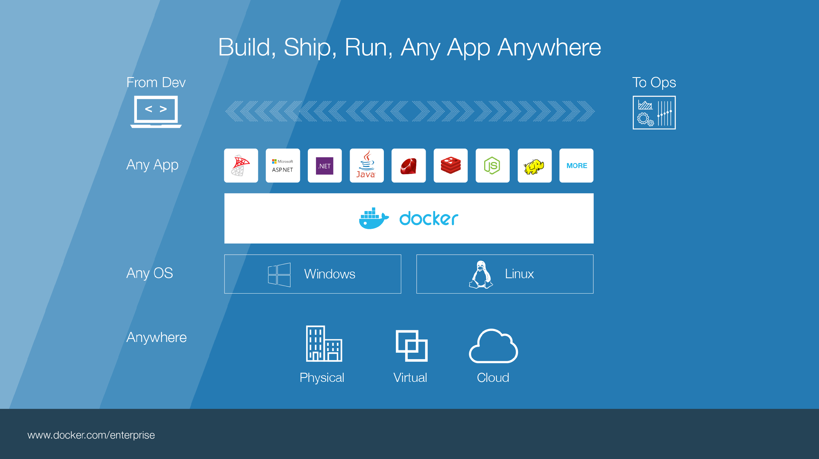
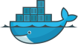
Notes:
Build, Ship, Run – Any App Anywhere – that’s Docker’s slogan
But, what does it mean?
What it essentially boils down to is that developers can choose whatever language or components they want to build their application – .Net, ASP, Java, Ruby, Redis, etc across both the Linux and Windows ecosystem. They are assured that whatever they code up, it will run wherever the Ops team chooses to deploy it – Physical, virtual, or cloud – it makes no difference to Docker.
An application written on a developers laptop will run exactly the same on the largest bare metal servers, in the cloud, even on a Raspberry Pi in my den.
Move applications seamlessly from dev to test to production.
Talk about linux vs Windows – Windows containers are windows only specific
Nano Server, which offers a minimal-footprint headless version of Windows Server
Windows Server, light UI version of Windows Server
Microsoft announced a new installation option, Nano Server, which offers a minimal-footprint headless version of Windows Server. It excludes the graphical user interface, WoW64 (support for 32-bit software) and Windows Installer. It does not support console login, either locally or via Remote Desktop Connection. All management is performed remotely via Windows Management Instrumentation (WMI), Windows PowerShell and Remote Server Management Tools (a collection of web-based GUI and command line tools).^{[25]} However, in Technical Preview 5, Microsoft has re-added the ability to administer Nano Server locally through PowerShell. According to Microsoft engineer Jeffrey Snover, Nano Server has 93% lower VHD size, 92% fewer critical security advisories, and 80% fewer reboots than Windows Server.^{[26][27]}

Slide 22
Docker Concepts

Slide 23
Image vs Container
Image – it is a template (application plus required binaries and libraries)
Container – a running instance of an image. Intended to be ephemeral.
Notes:
Class vs instance analogy

Slide 24
Image Tags
You reference an image via a Tag
Microsoft/dotnet:1.0.3-runtime
Name of owning repository + “:” + tag name
Repositories typically only contain highly related images
The default tag name is “default”

Slide 25
Docker Daemon
Builds images
Runs and manages containers
RESTful API

Slide 26
Docker CLI
pull - Pull an image or a repository from a registry
images - List images
run - Run a command in a new container
ps - List containers
rm - Remove one or more containers
rmi - Remove one or more images
Notes:
Command Line Interface
Mention Daemon may be remote

Slide 27
CLI Demo

Slide 28
Docker Layers
Each image consists of a series of layers
Union file systems allows common layers to be shared between images and containers
One of the reasons Docker is so lightweight
Notes:
Docker images are read-only templates from which Docker containers are instantiated. Each image consists of a series of layers. Docker uses union file systems to combine these layers into a single image. Union file systems allow files and directories of separate file systems, known as branches, to be transparently overlaid, forming a single coherent file system.
These layers are one of the reasons Docker is so lightweight. When you change a Docker image, such as when you update an application to a new version, a new layer is built and replaces only the layer it updates. The other layers remain intact. To distribute the update, you only need to transfer the updated layer. Layering speeds up distribution of Docker images and reduces the disk space required to host containers. Docker determines which layers need to be updated at runtime.

Slide 29
Docker Layers
Image 1
dotnetbot binaries
Image 2
dotnetbot source
whalesay binaries
Image 3
Image 4
.NET Core SDK
dotnetbot binaries
dotnetbot binaries
.NET Core Runtime
.NET Core Runtime
Windows Nano Server (10.0.14393.693)
Ubuntu 16.04

Slide 30
Dockerfile
Dockerfile is the set of instructions that define the image.
Every image starts from a base image. The base image is defined using the FROM keyword in the dockerfile.
Each instruction creates a new layer in the image.
Building a Dockerfile executes the instructions to produce an image.
Notes:
Using docker build users can create an automated build that executes several command-line instructions in succession.
https://docs.docker.com/engine/reference/builder/

Slide 31
Dockerfile Demo

Slide 32
What about data persistence?
Volumes allow you to specify a directory in the container that exists outside of the docker file system structure
Can be used to share (and persist) data between containers
Directory persists after the container is deleted
Unless you explicitly delete it
Can be created in a Dockerfile or via CLI

Slide 33
Mounted Volume Demo

Slide 34
Docker Hub / Docker Store
Implementations of a Docker Registry
Storage for your images
Free for public images
Cost for private images
Provides services
Automated build infrastructure (linked to SCC; triggered by commits)
Security analysis
Automated Deployment
Notes:
Docker Hub is the old
Docker Store is the new
Still in transition
Docker Store cost $
Monetizing compute

Slide 35
Docker Hub Demo

Slide 36
Docker Compose
Tool for defining and running multi-container applications with Docker
Define a multi-container application in a single file
Spin your application up in a single command
Notes:
Compose is a tool for defining and running multi-container applications with Docker. With Compose, you define a multi-container application in a single file, then spin your application up in a single command which does everything that needs to be done to get it running.

Slide 37
Compose Demo

Slide 38
Docker Community
8B+ Docker images downloaded
500,000+ Apps in Docker Hub
Docker launched March 2013
Docker platform is open source
Over 3000 community contributors
2/3 of the engine contributions are from outside
>300 PRs per week

Slide 39
Q & A

Slide 40
Visual Studio Tools for Docker
Build and debug within a container
Edit and Continue
Debug vs release Docker artifacts

Slide 41
Visual Studio Demo

